Slide 1
Adv. Java JAXB
Guided by:
Ms Vidya Jaykumar
Presented by:
Khandare Ekta N. MC22F14F039
Khachane Yadanti S. MC22F14F040
Khandare Akshata N. MC22F14F041
Kolhe Vaishnavi D. MC22F14F042

Slide 2
What is JAXB?
JAXB is Java Architecture for XML Binding Simple API for XML (SAX) and Document Object Module (DOM) are generic XML parsers.
They will parse any well-structured XML.
JAXB creates a parser that is specific to your Document Type Definition (DTD).
A JAXB parser will parse only valid XML (as defined by your DTD)
DOM and JAXB both produce a tree in memory where everything is a Node.
JAXB produces a tree of Objects with names and attributes as described by your DTD.

Slide 3
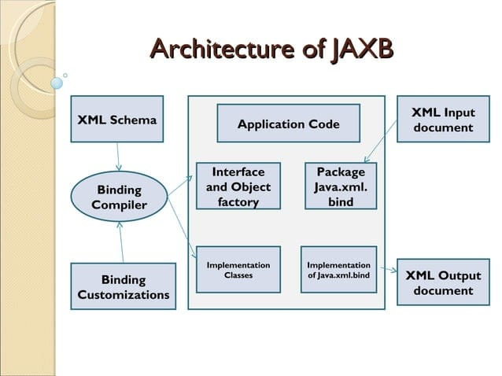
Architecture

Slide 4
Architecture
XML Schema: The purpose of an XML schema is to define a class of XML documents that must adhere to a particular set of structural rules and data constraints.
Binding Customizations: By default, the JAXB binding compiler binds Java classes and packages to a source XML schema based on rules.
Binding Compiler: The JAXB binding compiler is the core of the JAXB processing model and transforms a source XML schema to a set of JAXB content classes in the Java programming.

Slide 5
Architecture
4. Schema-Derived Classes: These specific classes will vary depending on the input schema.
5. Java Application: In the context of JAXB, a Java application is a client application that uses the JAXB binding framework to unmarshal XML data, validate and modify Java content objects, and marshal Java content back to XML data.
6. XML Input Documents: XML content that is unmarshalled as input to the JAXB binding framework -- that is, an XML instance document, from which a Java representation in the form of a content tree is generated.
7. XML Output Documents: XML content that is marshalled out to an XML document. In JAXB, marshalling involves parsing an XML content object tree and is valid with respect the source schema.

Slide 6
Major Features of JAXB
Ease of development
Typed access to XML content
Leverage Java SE 5 features100% XML Schema support
Java classes to XML Schema binding
Data binding for Java API for XML Web Services (JAX-WS)
Schema evolution• Provide optional on-demand validation of XML documents
Hides the complexity of DOM/SAX APIs
Is portable (A JAXB application should be able to utilize different JAXB implementations by just regenerating the schema classes and doesn't require change to the actual application code.)

Slide 7
Binding Process
Generate classes: An XML schema is used as input to the JAXB binding compiler to generate JAXB classes based on that schema.
Compile classes: All of the generated classes, source files, and application code must be compiled.
Unmarshal: XML documents written according to the constraints in the source schema are unmarshalled by the JAXB binding framework.

Slide 8
Binding Process
4. Generate content tree: The unmarshalling process generates a content tree of data objects instantiated from the generated JAXB classes.
5. Validate (optional): The unmarshalling process optionally involves validation of the source XML documents before generating the content tree.
6. Process content: The client application can modify the XML data represented by the Java content tree by means of interfaces generated by the binding compiler.
7. Marshal: The processed content tree is marshalled out to one or more XML output documents. The content maybe validated before marshalling.

Slide 9
Marshalling
Marshalling provides a client application the ability to convert a JAXB-derived Java object tree back into XML data.
Client applications are not required to validate the Java content tree before marshalling.

Slide 10
Unmarshalling
Unmarshalling provides a client application the ability to convert XML data into JAXB-derived Java objects.
Web Service App
XML ---->
XML ----> Java Object
Unmarshalling
XML <----
Java Object ----> XML
Marshalling

Slide 11
Annotations:
1. @XmlRootElement:
This maps a class or an enum type to an XML root element. When a top-level class or an enum type is annotated with the @XmlRootElement annotation, then its value is represented as XML element in an XML document.
2. @XmlAccessorType:
It defines the class fields that the JAXB engine uses for including into generated XML.
3. @XmlAccessorOrder:
It controls the ordering of fields and properties in the generated XML. We can have predefined values.
4. @XmlType:
It maps a Java class or enum type to a schema type. It defines the type name and is used to match the element in the schema to the element in the model.

Slide 12
Advantages
JAXB requires a DTD.
Using JAXB ensures the validity of your XML.
A JAXB parser is actually faster than a generic SAX parser.
A tree created by JAXB is smaller than a DOM tree.
It's much easier to use a JAXB tree for application-specific code.
You can modify the tree and save it as XML.

Slide 13
Disadvantages
You cannot use JAXB to process generic XML (for example, if you are writing an XML editor or other tool)
You must do additional work up front to tell JAXB what kind of tree you want it to construct.
But this more than pays for itself by simplifying your application.

Slide 14
Conclusion
Thus, JAXB poses as a means to simplify access to an XML document from a Java program allowing you to access and process XML data without having to know XML or XML processing.
JAXB uses memory efficiently and is flexible.

Slide 15
Thank You

